Slide 1
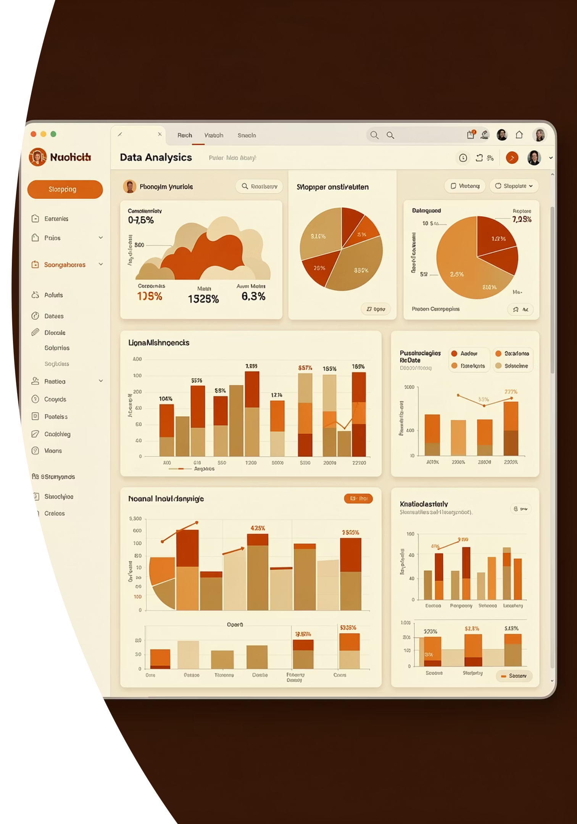
Customer Shopping Behaviour Analysis
Uncovering spending patterns, customer segments, product preferences, and subscription behaviour from 3,900 transactional records to guide strategic business decisions.

Slide 2
Dataset at a Glance
3,900
18
37
Purchases
Columns
Missing Values
Total transactional rows analysed
Rich feature set per transaction
In Review Rating column only
Demographics
Purchase Details
Behaviour
Age, Gender, Location, Subscription Status
Item, Category, Amount, Season, Size, Colour
Discounts, Promo Codes, Frequency, Ratings, Shipping

Slide 3

Data Preparation in Python
01
Load & Explore
Imported dataset with pandas; used df.info() and describe() for structure and summary statistics.
02
Clean & Standardise
Imputed missing Review Ratings using median per product category; renamed columns to snake_case.
03
Feature Engineering
Created age group bins and purchase_frequency_days; dropped redundant promo_code_used column.
04
Database Integration
Loaded cleaned DataFrame into PostgreSQL for structured SQL analysis.

Slide 4
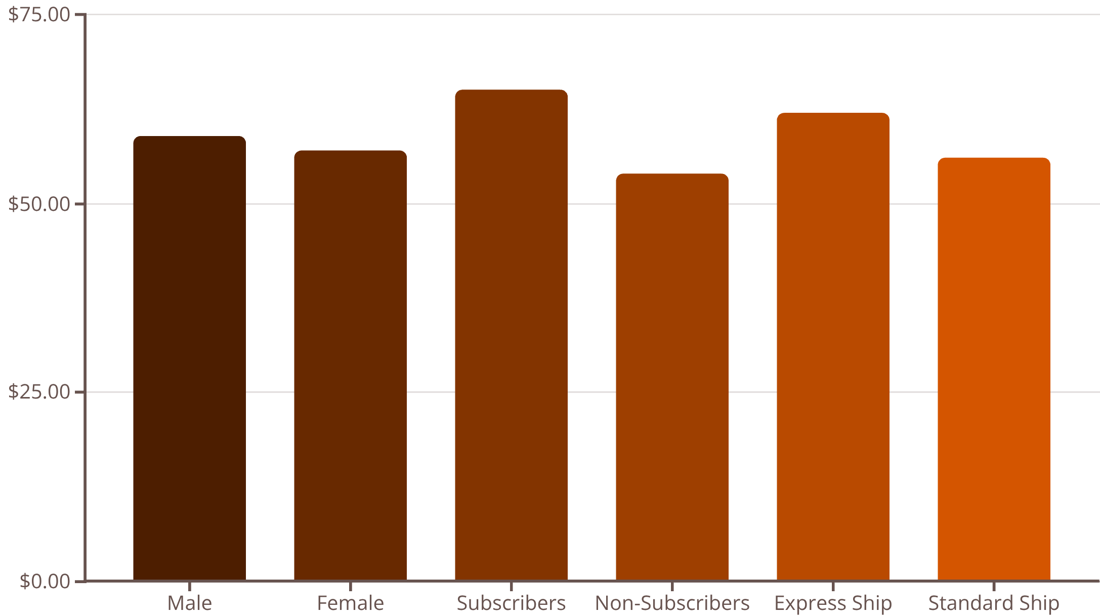
SQL Analysis: Revenue & Spending Insights
Key Revenue Findings
Gender: Male and female customers show comparable total revenue.
Subscribers outspend non-subscribers on average.
Express shipping users tend to spend more per transaction than standard shipping users.
High-spending discount users were identified — spending above average even with discounts applied.

Slide 5

Product Performance & Discount Dependency
Top 5 Products by Rating
SQL queries surfaced the highest average review-rated products — prime candidates for marketing campaigns.
Discount-Dependent Products
5 products were flagged with the highest percentage of discounted purchases, signalling potential margin risk.

Slide 6


Customer Segmentation
Customers were classified into three segments based on purchase history:
New
Returning
Loyal
First-time buyers with limited purchase history
Customers with moderate repeat purchases
High-frequency buyers — most likely to subscribe
Customers with more than 5 purchases showed a significantly higher likelihood of holding an active subscription.

Slide 7
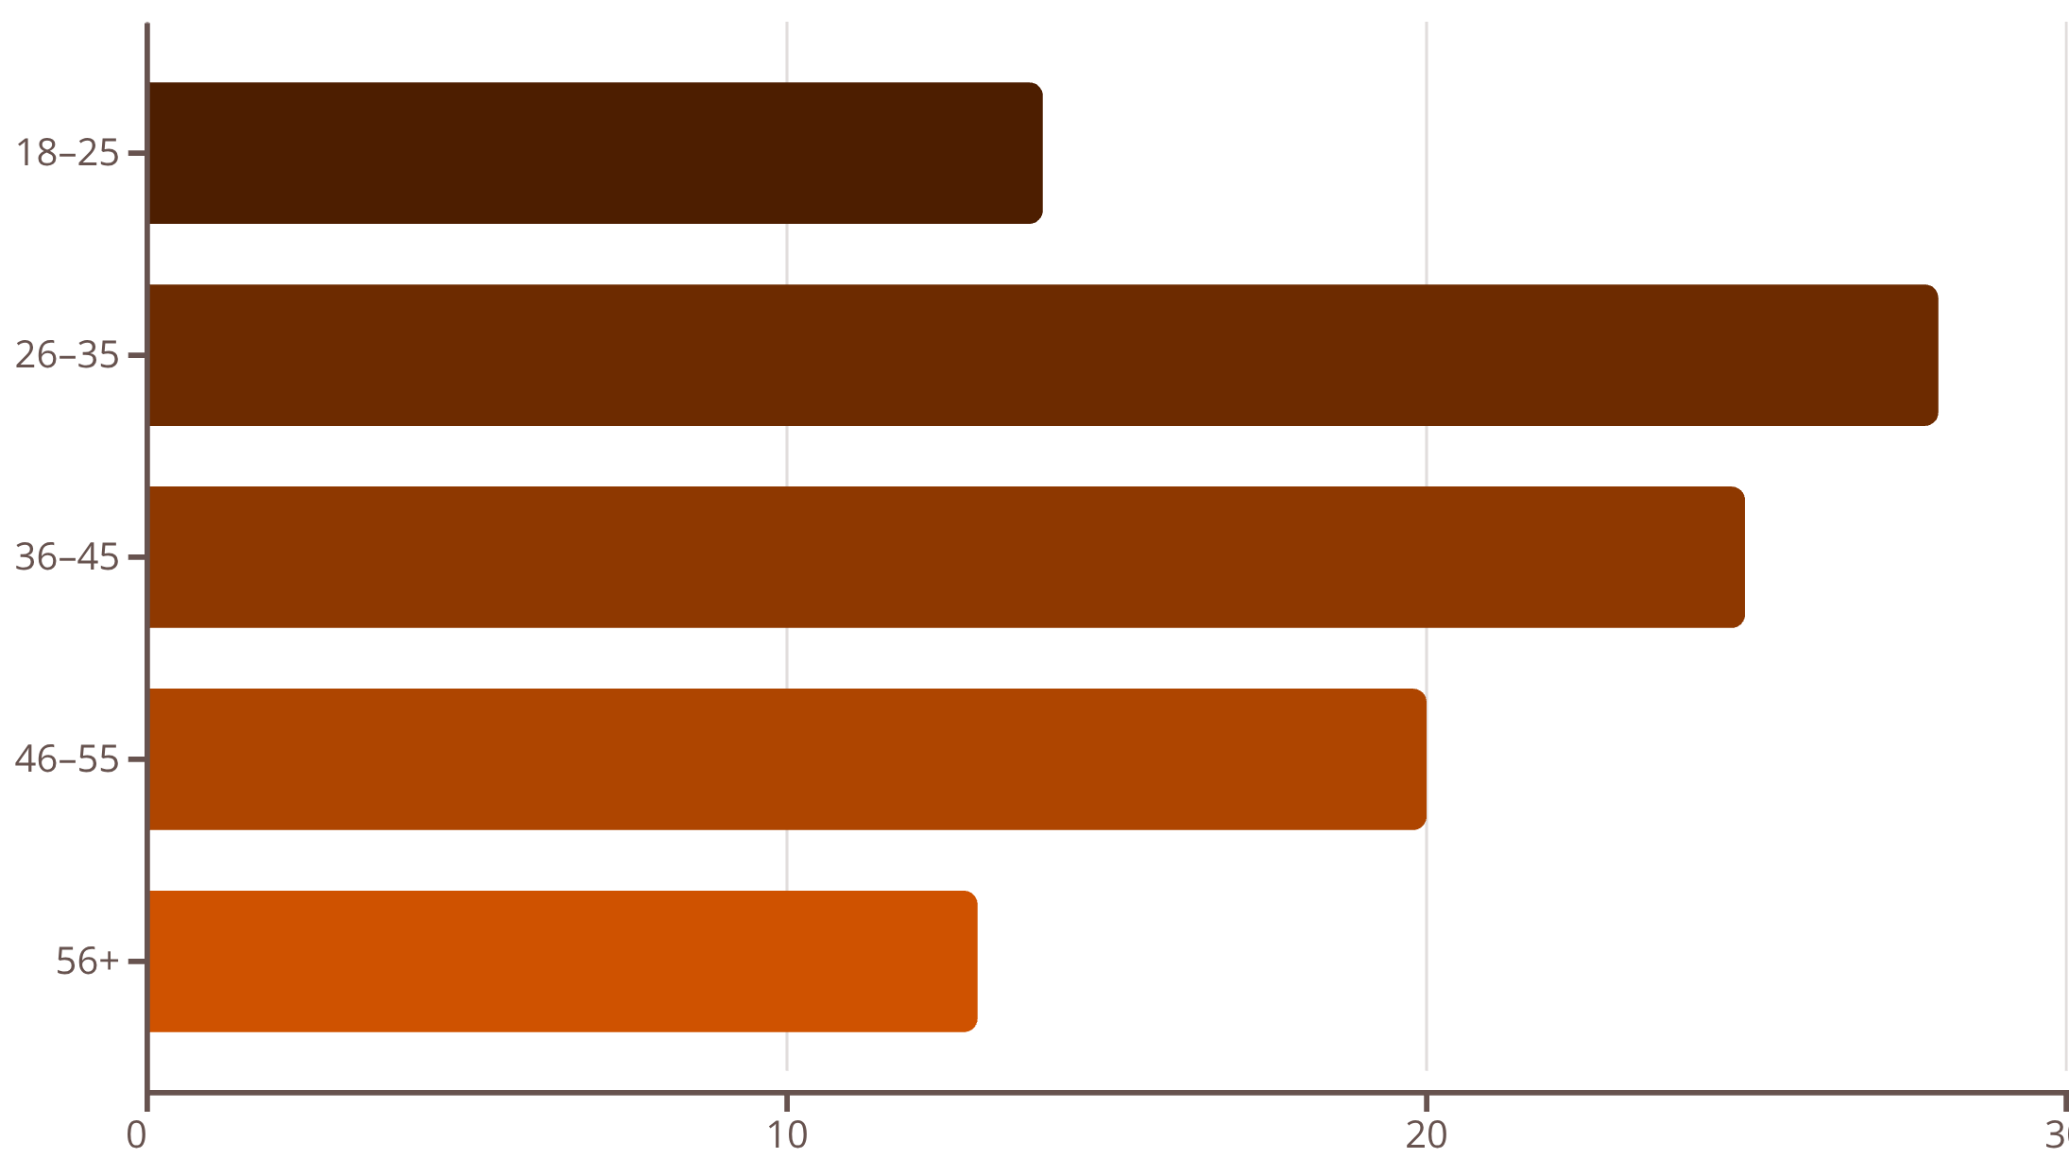
Revenue by Age Group & Top Products per Category
Top 3 Products per Category
SQL identified the most purchased products within each category — enabling smarter inventory and promotional planning.
The 26–45 age band contributes the largest share of total revenue, making them the primary target demographic.

Slide 8
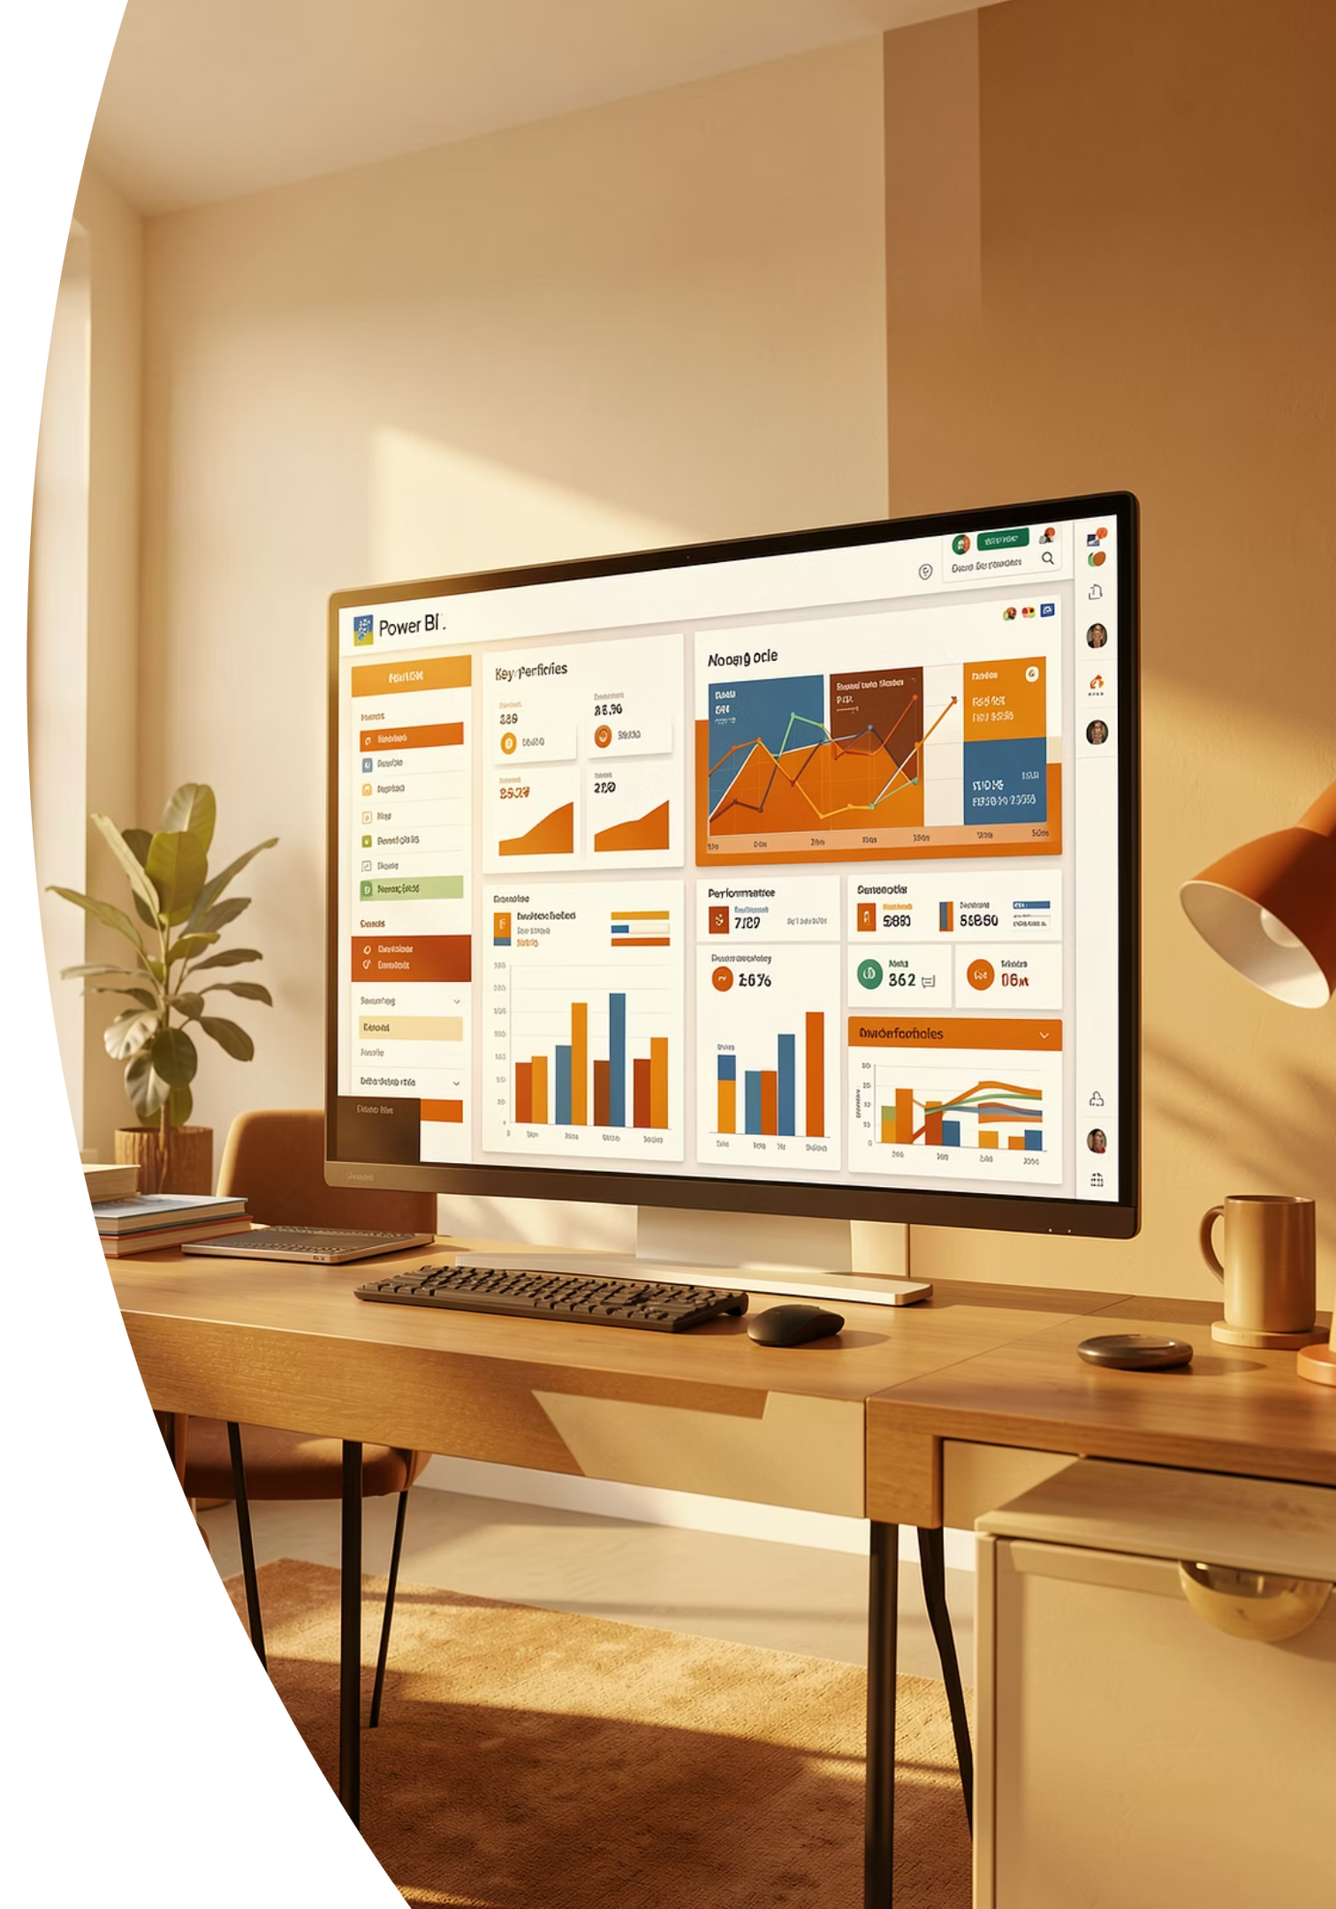
Power BI Dashboard
An interactive dashboard was built in Power BI to present all insights visually — enabling stakeholders to explore spending patterns, segment breakdowns, product performance, and subscription trends at a glance.

Slide 9
Business Recommendations
Boost Subscriptions
Loyalty Programs
Review Discount Policy
Promote exclusive benefits to convert non-subscribers.
Reward repeat buyers to move them into the Loyal segment.
Balance sales boosts with margin control on discount-heavy products.
Targeted Marketing
Product Positioning
Focus on high-revenue age groups and express-shipping users.
Highlight top-rated and best-selling products in campaigns.

Slide 10

Key Takeaways
Data-Driven Foundation
3,900 records cleaned and enriched using Python, then analysed in PostgreSQL for robust business insights.
Subscribers & Loyal Buyers Drive Revenue
Repeat buyers and subscribers consistently outspend other segments — retention is key.
Actionable Intelligence
From discount policy to age-targeted campaigns, every recommendation is grounded in transactional evidence.

